Slide 1
Internship: Final Presentation

Slide 2
INTERNSHIP DOMAIN:
JAVA WEB APPLICATION DEVELOPMENT
Project Work
on
“MovieZone Web Application"
Student Name | Vinod B Bhorge Suhas J Bhat
College Name | Proudhadevaraya Institute of technology
Branch | Computer Science Engineering
USN / Reg No | 3PG20CS055, 3PG20CS047
Internship Duration | 4 Weeks ( 14th August 2023 to 15th September 2023)
Company Internship Guide | Mr. Nagamahesh B S, Senior Software Developer and Director

Slide 3
Internship Tasks
About Company
Internship Task
Introduction on Project work / Roles
Software Details
Implementation Details
Skills Utilized
What I Learnt ?
Internship Outcomes
Project Demo / Screenshots
Conclusion
3

Slide 4

About company
InfiData Technologies An ISO 9001:2015 Certified IT Company, Accredited by An International Accreditation Service (IAS). Head quartered in "silicon valley" of India Bengaluru, started in the year 2015. We are highly specialized in the design and development of websites, software application development, mobile app development, E-Commerce solutions and more.
Our team of expert professionals works on the latest software tools and technologies to give the best and promising services to our customers.
OUR SERVICES
Development | Training |Consulting
Address:
#1421, 1st Floor,16th B Cross, Sri Radha Building, Opp To Dr. Agarwal Eye Hospital, Yelahanka New Town, Bengaluru-64
www.infidata.in | info@infidata.in
4

Slide 5
Internship Tasks
Task on:
Core Java Concepts
Java Database Connectivity
SQL Queries
HTML and CSS
Working with Web Templates
Servlet Programming
Java Server pages (JSP)
Project Work
5

Slide 6
Introduction to Project Work / Roles
Project Name: MovieZone Web Appplication
Online Movie Tickets Booking for Sandalwood , Hollywood , Bollywood ,Tollywood and other Industries.
User want to login before entering the web-page with correct user details.
Choose the movie when you want to watch and then choose the showtime and number of tickets.
Where user can easily access the information about movie like name of Director with required

Slide 7
Software / Hardware Tools Details
Software:
JDK
Eclipse for Web and Enterprise Developer
XAMPP
Hardware :
Minimum PC Requirements

Slide 8
Implementation Details
Login of a User:
Login form is provided for the people who wish to book the tickets with available showtime .We have done this using HTML forms and Databases.
2.Trending Movie List:
There is a list displayed in order to show the trending films where user can see Trailers. We used JSP to provide a list of members who have registered.
3. Booking of Tickets:
We have provided the correct user details for booking like email , showtime, number of tickets and display the corresponding receipt for user.

Slide 9
Implementation Details
4. Contact us:
If the user having any query or any help they can contact the developer .This is done with the help of HTML and CSS forms again.

Slide 10

Skills Utilized
Software Engineering Skills
Algorithms and Model Building
Administrative and collaboration tools using GitHub.

Slide 11
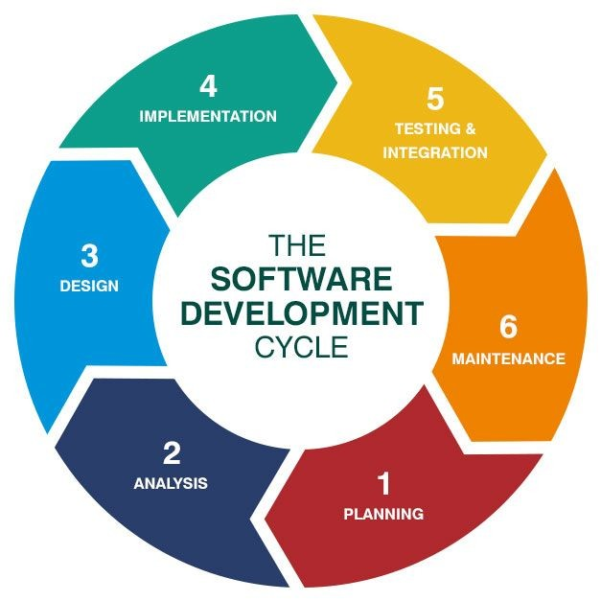
Skills Utilized
Front-end Development: HTML, CSS, JavaScript
Back-end Development: java servlets & Java Server Pages (JSP), Database Management
User Authentication and Security
E-commerce Functionality
Email Integration

Slide 12
What I learnt ?
Technical skills:
Soft skills:
Management skills:
Advance Java
Web Development
Database Connectivity
Servlets and JSP
Teamwork
Communication Skills
Design Working Culture
Project Management
Time Management
and more

Slide 13
Weekly Training/ Task Completion
Week | Date | Training Details | Task Details
1 | 14th Aug 23 to 19th Aug 23 | Java basics | Learnt fundamentals Java concepts, variables, data types &basic syntax.
2 | 21th Aug 23 to 26th Aug 23 | HTML basics | Basic HTML tags, structures & elements for web development.
3 | 28th Aug 23 to 26th Aug 23 | Servlets | Understand java Servlets, their life cycles, and how to handle HTTP request.
4 | 4th Sep 23 to 9th Sep 23 | JSP | Explore JSP for dynamic web content, including scripting & tag libraries.
5 | 11th Sep 23 to 15th Sep 23 | Project ,Test & Presentation | Develop a web project using java, HTML, Servelts & JSP.

Slide 14

Internship Outcomes
Now I am able to design applications
Growth : Critical Thinking and analysis
Lead the team and projects
Skill Enhancement
Practical Experience
Confidence Building

Slide 15
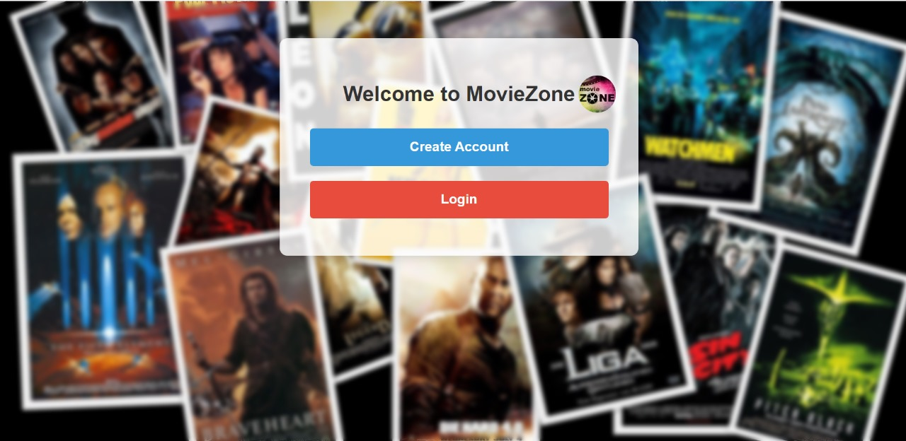
Project Demo / Screenshots

Slide 16
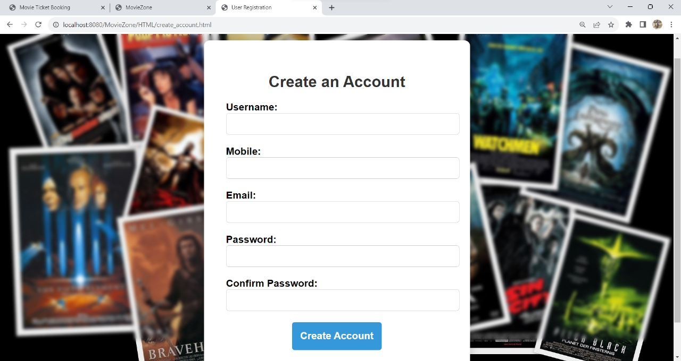
Project Demo / Screenshots

Slide 17
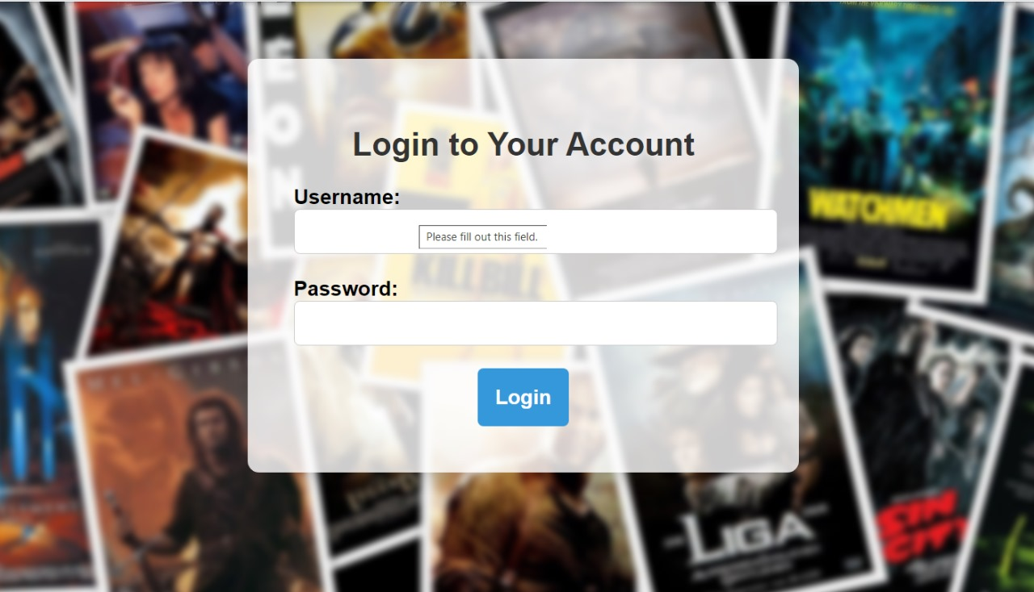
Project Demo / Screenshots

Slide 18
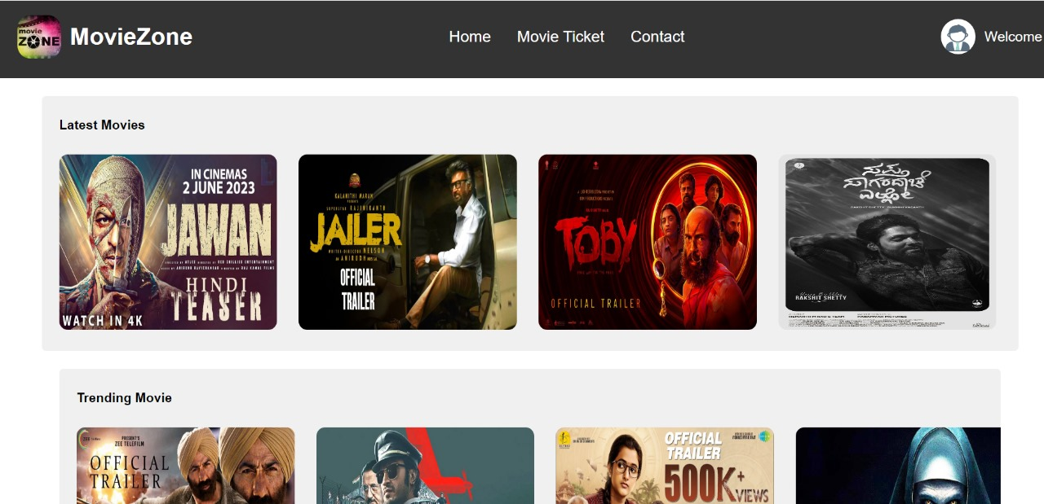
Project Demo / Screenshots

Slide 19
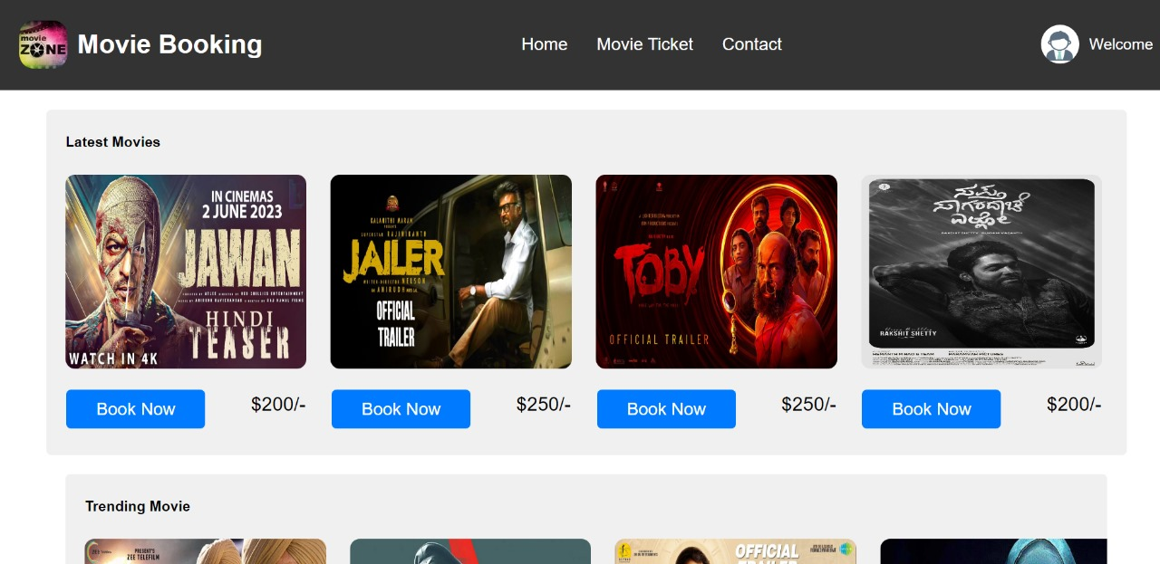
Project Demo / Screenshots

Slide 20
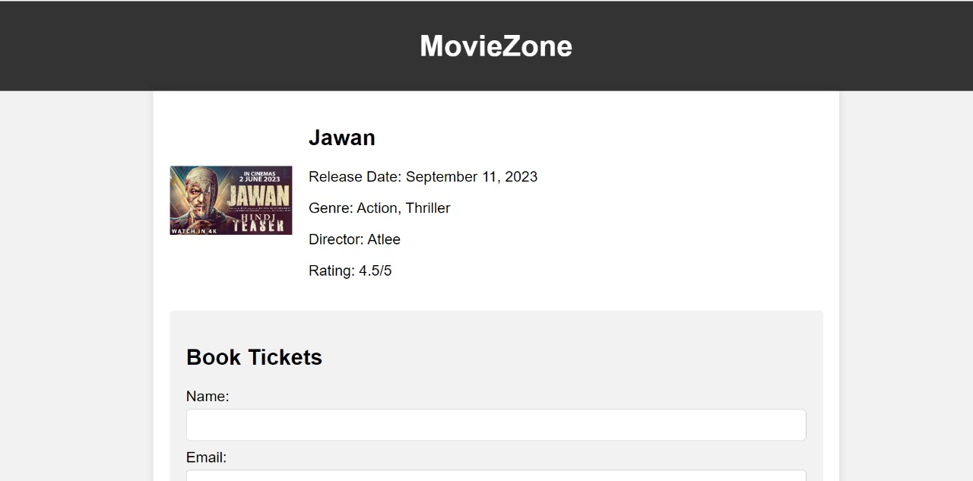

Slide 21
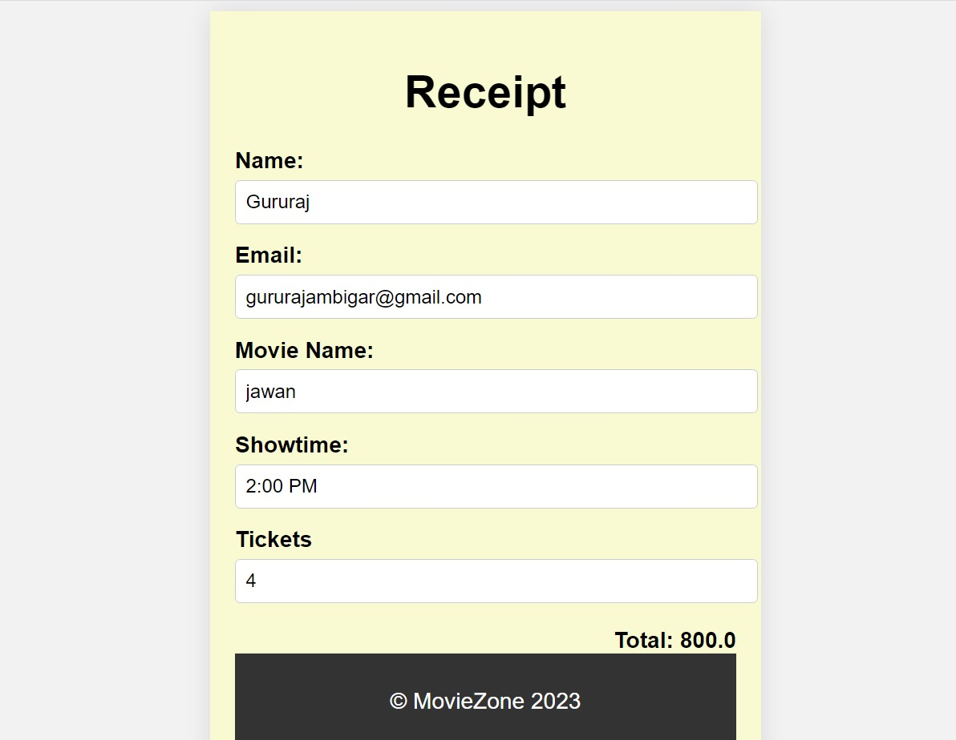

Slide 22

Conclusion
This internship has been an excellent
and rewarding experience.
It was a great opportunity to improve personal and professional skills.
These valuable skills have boosted my professional skills to a higher level and prepare me for future career.

Slide 23
Thank You

